Slide 1
Missouri Teacher Candidate Assessment Rubric Calibration Training

Slide 2
This training is a partnership of
DESE &
MACTE

Slide 3
Objectives of Online Training
Knowledge of Missouri Teacher Candidate Assessment Rubric protocol and rationale of its use
Calibration of scoring for the Missouri Teacher Candidate Assessment Rubric

Slide 4
Important Terms
Missouri Teacher Standards: see next slide
Teacher Candidate: Also called student teacher, intern. Student in an initial teacher preparation program completing the culminating field experience, traditionally called student teaching.
Cooperating teacher: individual employed by the school district and assigned to supervise the teacher candidate. Also called mentor teacher.
University supervisor: individual employed by the educator preparation program who directly supervises teacher candidates in the field.
Educator preparation program or EPP: university, college, or organization preparing the teacher candidate, responsible for recommending teacher candidates for certification.
Notes:
DESE has specific qualifications for both cooperating teachers and university supervisors. You may also hear teacher candidates referred to as student teachers, interns, etc. You may also hear cooperating teachers referred to as mentor teachers.

Slide 5
Missouri Teacher Standards
Nine standards that “convey the expectations of performance for professional teachers in Missouri.” These can be aligned with the InTASC standards.
Unfamiliar with these? Click here to view them.

Slide 6
Missouri Teacher Standards
Standard 1: Content knowledge aligned with appropriate instruction
Standard 2: Student learning, growth, and development
Standard 3: Curriculum implementation
Standard 4: Critical thinking
Standard 5: Positive classroom environment
Standard 6: Effective communication
Standard 7: Student Assessment and Data Analysis
Standard 8: Professionalism
Standard 9: Professional collaboration

Slide 7
2. Why do I need training?
Missouri Teacher Candidate Assessment Rubric

Slide 8
Teacher Candidate Assessment Rubric
Every teacher candidate in the state will be evaluated by their cooperating teacher and university supervisor using the same instrument.
Candidates must receive a specified score to receive teacher certification.
Scores are reported on the EPP Annual Performance Report.
Notes:
All candidates are held to the same expectations.

Slide 9
Calibration on Teacher Candidate Assessment Rubric is important.
The rubric provides feedback to the candidate on his or her performance.
Notes:
The rubric articulates the expectations of the state of Missouri for teacher candidates.

Slide 10
Teacher Candidate Assessment
Throughout the clinical experience, teacher candidates receive feedback. You will receive specifics on the frequency and type of formative feedback from the EPP.
Assessment includes observation of performance and other evidence and artifacts.
Each of the nine teacher standards must be assessed by the end of student teaching. Both the cooperating teacher and university supervisor must submit a score on every standard.

Slide 11
3. Rubric Design
Observable behaviors and evidence provided by teacher candidate

Slide 12
9 Teacher Standards
Score of 0-4 on each
Certification assessment
The same standards used for practicing teachers.
3 is the target by the summative evaluation.
Notes:
Both university supervisor and cooperating teacher will score. The EPP will provide details on how and when to submit scores
Cut score is 42.

Slide 13
Overall Guide to Levels of Performance
Language in the rubric (descriptors) is what matters.
0=No evidence of performance
1=Plans or intends to use the skill but does not implement in performance
2=Attempted to implement but may not have been successful or effective
3=Target performance for teacher candidate
4=Only used if all descriptors for level 3 have been met.

Slide 14
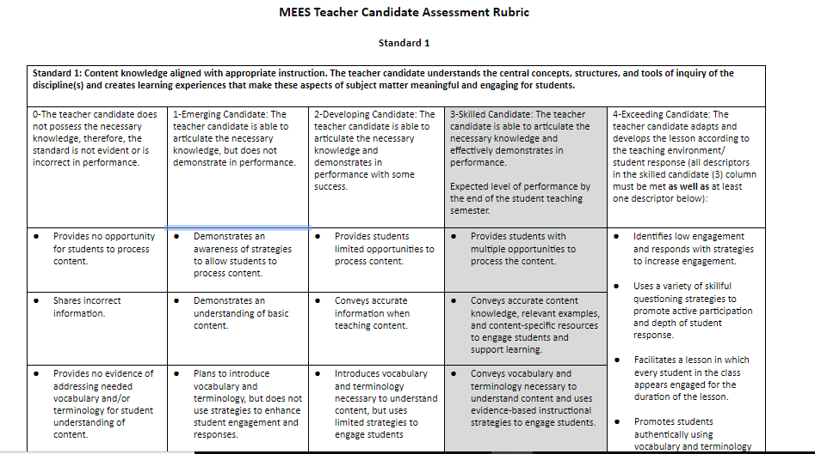
Let’s look at the first part of the rubric. Note the progression from 0 to 3 across the strands.

Slide 15
Teacher Candidate Assessment Rubric
Each standard has multiple strands describing observable behaviors.
Highlight the descriptor that is appropriate for the performance or evidence you observed throughout the semester.
Comment to explain your score.
The score is calculated based on the column where the majority of strands are highlighted.

Slide 16
4. Scoring Protocol
Review the rubric. You will be prompted to make a copy of this document in your Google Drive.
https://docs.google.com/document/d/1RcBvCHexl8bPmeTxnAJCt3P10iFole7gMHY34NrKsNE/copy?usp=sharing
Don’t want to use Google? Access the document in PDF here:
https://dese.mo.gov/sites/default/files/MEESTeacherCandidateAssessmentRubricUpdated2019FINAL.pdf
Review the scoring protocol
https://dese.mo.gov/sites/default/files/MEESTeacherCandidateSummativeScoringProtocol2019-2020.pdf

Slide 17
How to Score
What evidence was observed or documentation provided by the candidate?
Each standard is a separate score. A candidate may be strong on one but not on another.
The score is not how much we like the candidate or their potential
The score is not about what they could have done during the observation
If unsure on a score, use the language on the rubric. Highlight what was observed.
Ask yourself, Why not the higher score? Why not the lower score?
Think about how a conference with the teacher candidate would work. What feedback would you give?

Slide 18
Scoring Protocol
For levels 0 – 3, a score earned on a majority of the strands will be the score assigned to that standard.
For standards with an even number of strands, if the scores are split evenly between two adjacent levels, the lower score will be given.
If neither of the first two rules applies, the mean of all strand scores should be calculated and used as the standard score. This score should be rounded down if the mean is *.5 or lower and rounded up if it is greater than *.5.
https://dese.mo.gov/sites/default/files/MEESTeacherCandidateRubricScoringProtocol2019-2020FINAL.pdf

Slide 19
Summative Scoring
Based on what you observed and evidence, not candidate’s potential.
Many EPPs will have midterm and formative feedback requirements.
The language is designed to be evidence-based and positive, based on what is, rather than what is missing or lacking.
In the next example you will see a Standard 1 score of 2. Note that the candidate scored in the 1 column for the last row.
The score is calculated on the majority of rows selected.

Slide 20
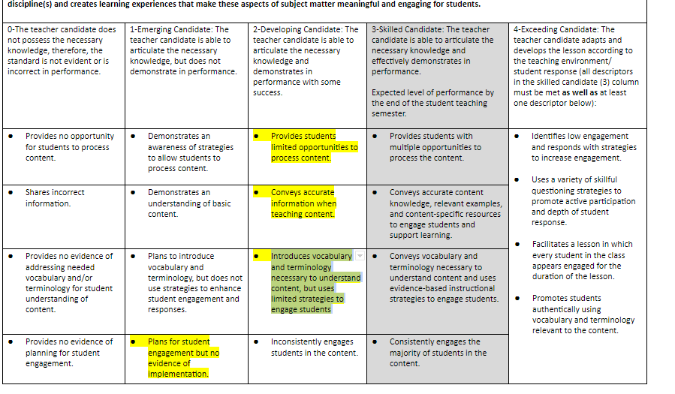
Example of Rule 1:
Score of 2

Slide 21
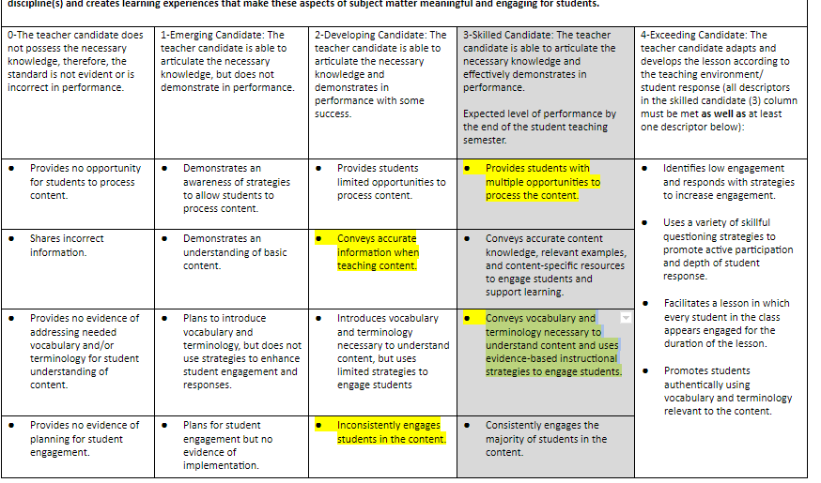
Example of Rule 2: Score of 2

Slide 22
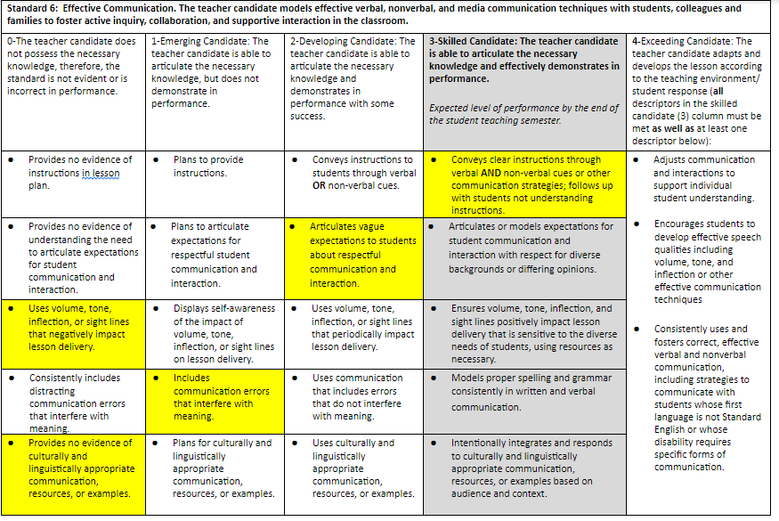
Example of Rule 3: Score of 1
Notes:
Use the chart on p. 8
https://dese.mo.gov/sites/default/files/MEESTeacherCandidateSummativeScoringProtocol2019-2020.pdf

Slide 23
For a score of 4, the candidate must have ALL strands in the 3 column selected and at least one from the 4 column.

Slide 24
If you’re not sure what score . . .
Scores are reported as whole numbers.
If you have any questions, refer to p. 8-11 of the protocol or ask your EPP university supervisor.
Any questions?
Please contact your Educator Preparation Program field experience office.

Slide 25
THANK YOU!
The mentoring you provide to the teacher candidates is essential to their preparation.
Teacher preparation is partnership.

Slide 26
Credits
Special thanks to all the people who made and released these awesome resources for free:
Presentation template by SlidesCarnival
Photographs by Unsplash

